Slide 1
NeedleBench: Can LLMs Do Retrieval and Reasoning in Information-Dense Context?
By Lukas Czurgel

Slide 2
Table of contents
Motivation and Background
What is a context window?
Why we care about long context retrieval
The Needle in a Haystack
Related Work
NIHA
RULER
LongBench
NeedleBench
Methodology
Evaluation
Results
Summary

Slide 3
Table of contents
Building on NIH Testing
Needle bench
Overview
Related Work
Methodology
Experiments
Findings
Summary

Slide 4
Motivation & Background

Slide 5
Background – What is a context window?
Context windows can be thought of as the working memory or RAM of models with the transformer architecture
It contains things like the prompt, system prompt, conversation history and any additional documents relevant for the task at hand
Since this space is limited, we often use RAG to pre-select sections to include in the context window

Slide 6
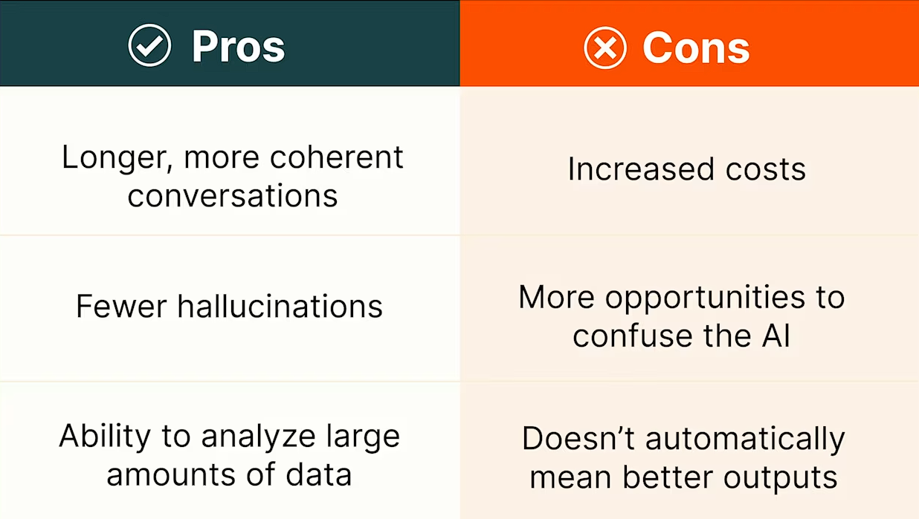
Motivation – Why long context retrieval?
Question: How do we evaluate long-Context LLMs?

Slide 7
Motivation – Why long context retrieval?
RAG: More content can be included
Chatbots: Conversations can be longer before the model ‘forgets’ previous exchanges
Eventually: Potentially replace RAG with ultra long context models
Question: How do we evaluate long-Context LLMs?

Slide 8
The needle in a haystack Test (NIHA)
Place a fact or statement (the needle) inside a chunk of a body of unrelated text (the haystack)
01
Provide the LLM with this text and a prompt asking about the needle
02
Iterate over various document depths (where the needle is placed) and context lengths to measure performance
03
Aggregate the results and evaluate accuracy
04

Slide 9
Related Works

Slide 10
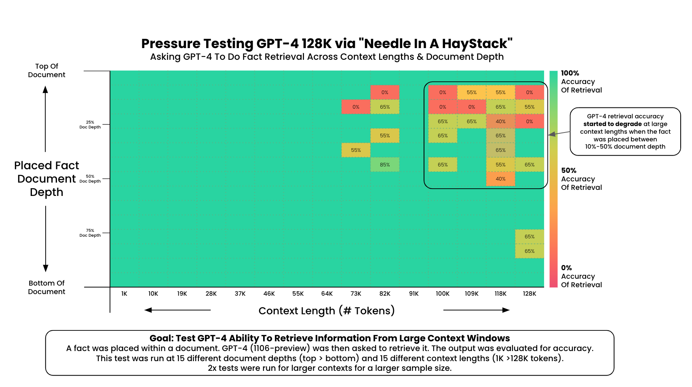
Related Work
LLMTest NeedleInAHaystack: The Initial test developed by Developed by Greg Kamradt
RULER (Hsieh et al.): short description.
LongBench(Bai et al.): short description.

Slide 11
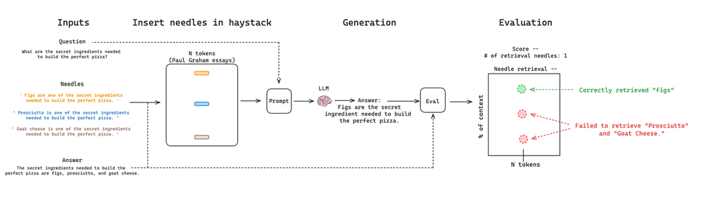
Related Work – Needle in a Haystack (G. Kamradt)
Limitations:
Needles are irrelevant filler content and require no reasoning ability
Modern LLMs crush the basic NIHS test

Slide 12
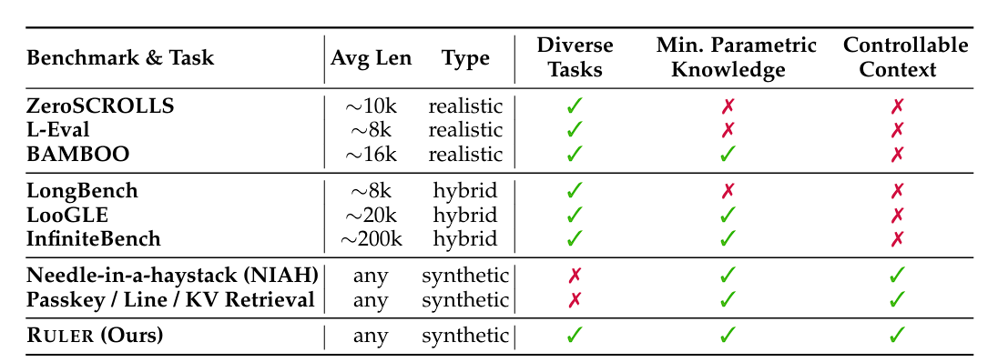
Related Work - Ruler (Hsieh et al.)
RULER : shows that passing retrieval tests does not always mean robust understanding. Models can focus on certain key points to find the needle.

Slide 13
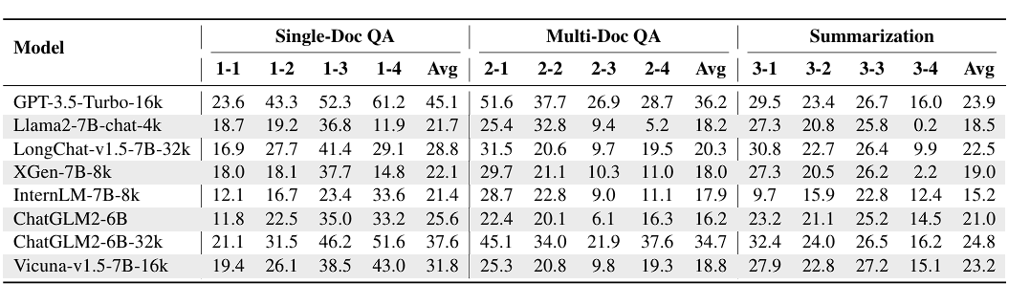
Related Work - Longbench (Bai et al.)
LongBench(Bai et al.): more realistic tests run the risk of allowing the model to rely on its general knowledge to answer the test questions even without finding the needle

Slide 14
Related Work - Longbench
RULER (Hsieh et al.): shows that passing retrieval tests does not always mean robust understanding. Models can focus on certain key points to find the needle.
LongBench(Bai et al.): more realistic tests run the risk of allowing the model to rely on its general knowledge to answer the test questions even without finding the needle

Slide 15
The Needlebench Framework

Slide 16
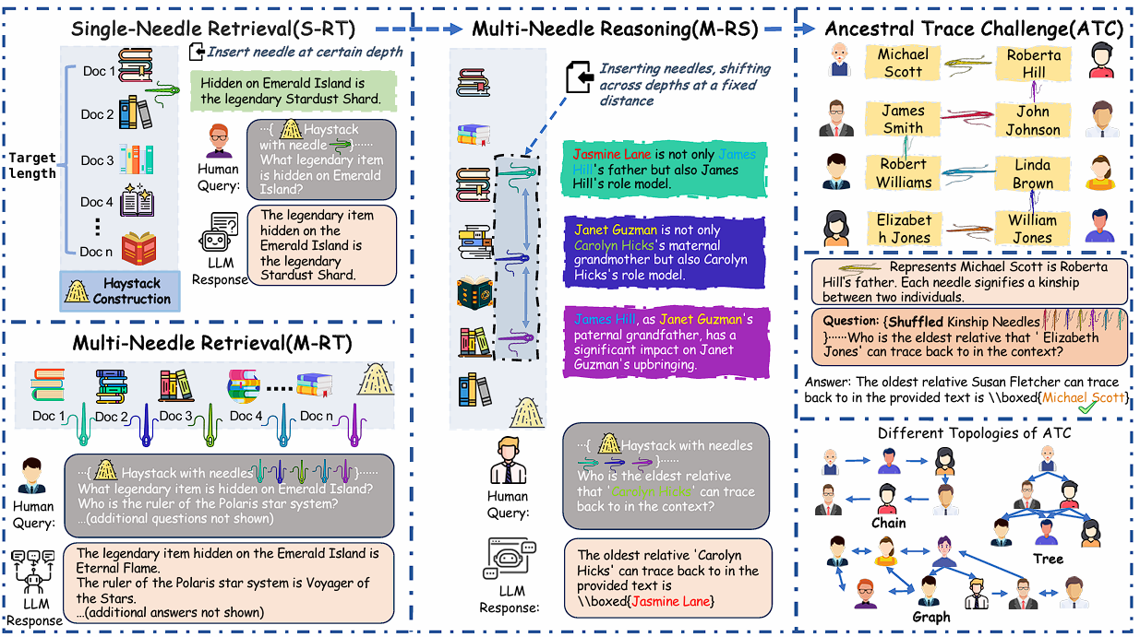
NeedleBench (Mo Li et al. )

Slide 17
NeedleBench: Can LLMs Do Retrieval and Reasoning in Information-Dense Context?
Published by Mo Li et al. in https://arxiv.org/abs/2407.11963
Aims to provide a more sophisticated Benchmarking framework

Slide 18
Needle bench – Methodology
assess retrieval and reasoning performance in bilingual long-context tasks
context lengths of (e.g., 32k, 128k, and beyond)
Two types of tests
information-sparse, characterized by minimal relevant details embedded within extensive irrelevant text to simulate simpler real-world retrieval tasks;
information-dense, implemented as the Ancestral Trace Challenge, where relevant information is continuously distributed throughout the context to simulate more complex real-world reasoning tasks.

Slide 19
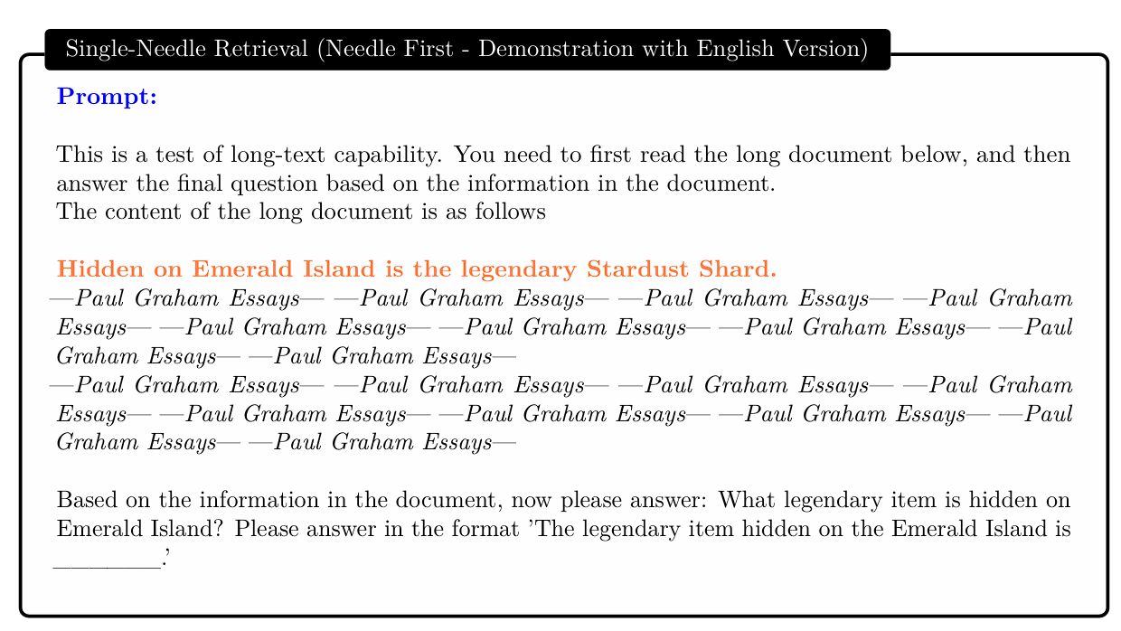
Information-Sparse Tasks
Three types of tests:
Single-Needle Retrieval Task (S-RT)
Multi-Needle Retrieval Task (M-RT)
Multi-Needle Reasoning Task (M-RS)

Slide 20
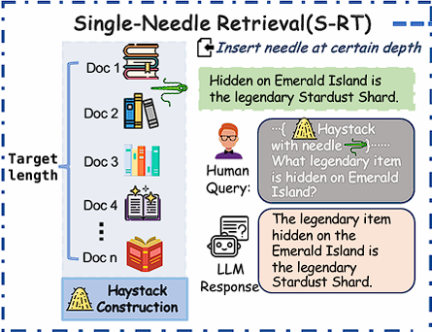
Single-Needle Retrieval Task (S-RT)
Tests LLMs’ ability to recall a single key information (needle)
Needle: synthetic, abstract, and fictional statements or relational facts
Most basic application of a NIHA

Slide 21
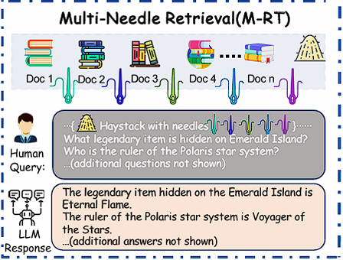
Multi-Needle Retrieval Task (M-RT)
Expands S-RT to multiple needles
simulating complex real-world queries that require extracting several data points
Needles are still independent

Slide 22
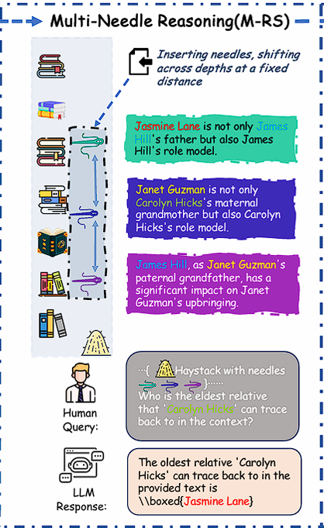
Multi-Needle Reasoning Task (M-RS)
Expands on M-RT by requiring reasoning across multiple datapoints
Each needle provides a piece of the puzzle
Finding each needle may be required to answer the query

Slide 23
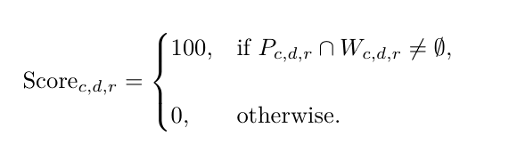
Information-Sparse Tasks: Evaluation
c represents the context length
d represents the needle depth or position
r represents the index of repetition.
Full credit is awarded if any keyword from Wc,d,r appears in Pc,d,r, and zero otherwise

Slide 24
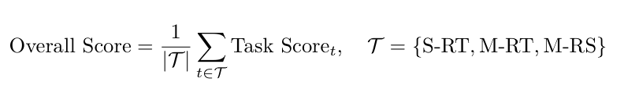
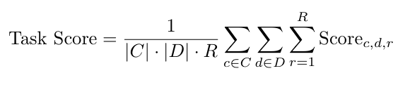
Information-Sparse Tasks: Evaluation
C represents the set of context lengths
D represents the set of needle depths or positions
R represents the number of repetitions for each configuration.
The test was repeated R=10 times for each configuration

Slide 25
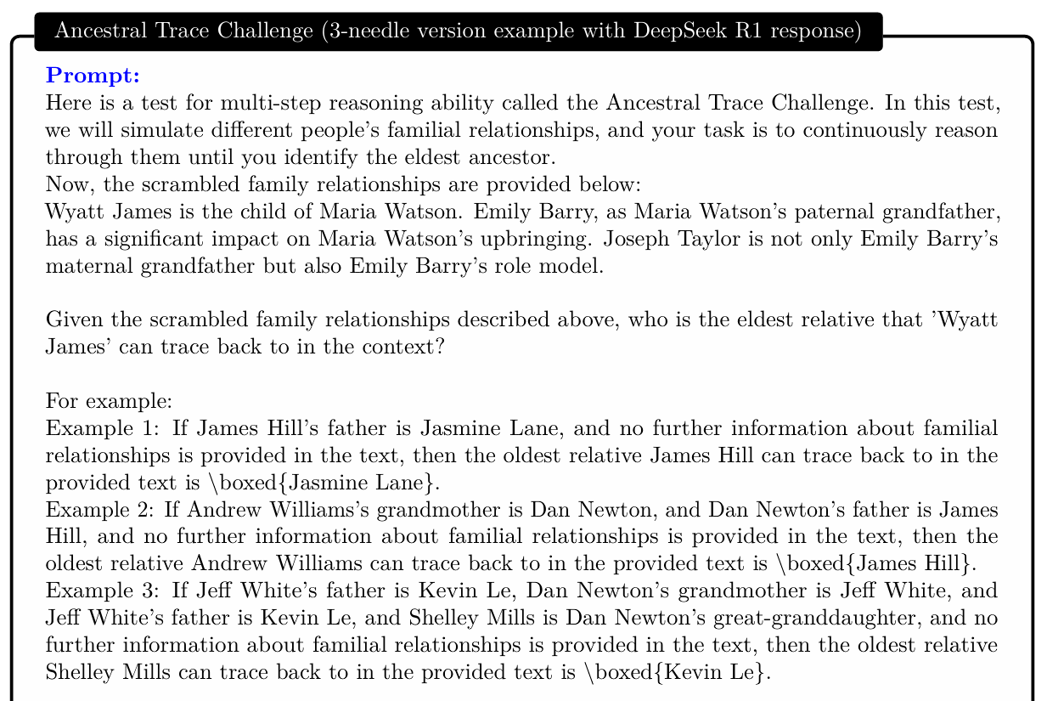
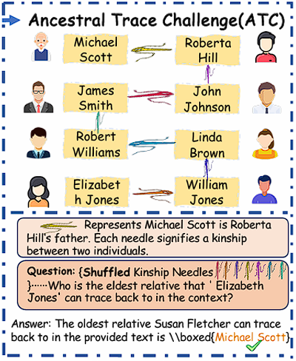
Information-Dense Tasks

Slide 26
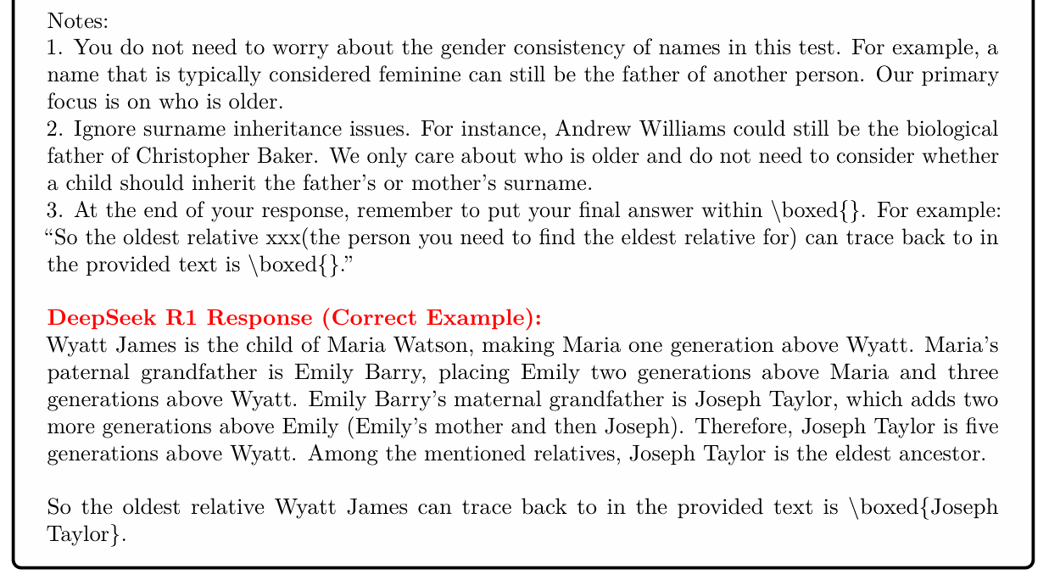
Information-Dense Tasks
Diversity of ATC Tasks:
Randomized names
Tasks model various family dynamics
Relationship distance, n-th eldest ancestor etc.
Varied needle count and context length
Tested both in English and Chinese

Slide 27
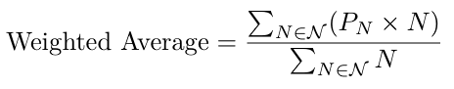
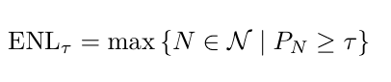
Information-Dense Tasks: Evaluation
Weighted exact match metric
Weights are proportional to task difficulty (needle count)
Measured across different difficulty levels
ENL τ : the maximum task difficulty at which the model can still achieve at least τ % accuracy
The test was repeated R=10 times for each configuration, τ = 50.

Slide 28
Experiments

Slide 29
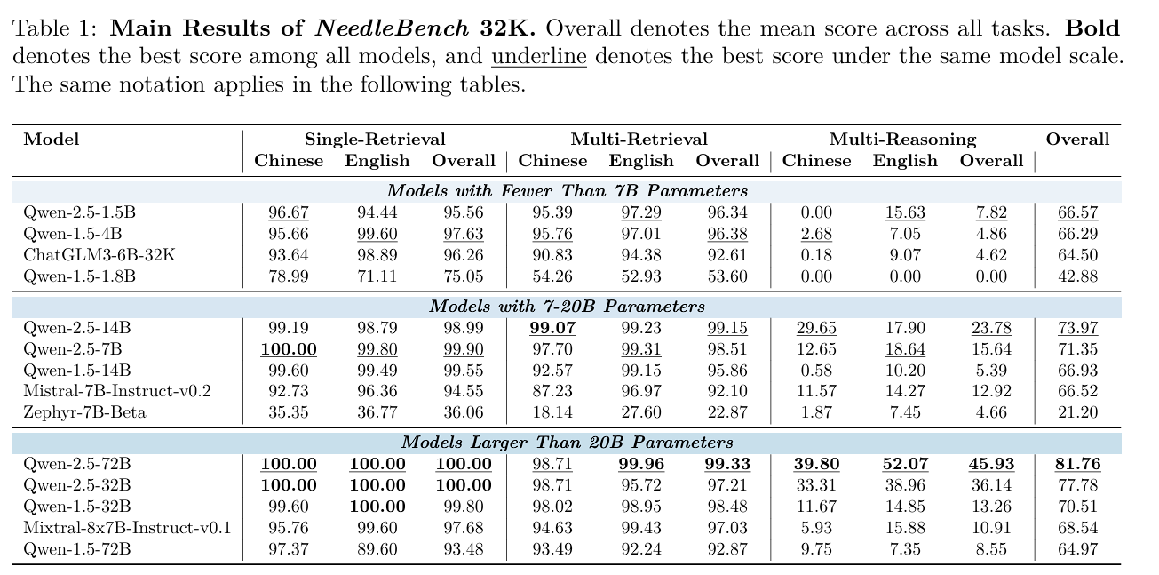
Information-Sparse Tasks: Results
Evaluation of several Parameters:
Impact of Model Architecture and Generation
Effect of Model Scale on Multi-Needle Reasoning Performance
Effect of Needle Count on Multi-Needle Reasoning Performance
Impact of Language

Slide 30
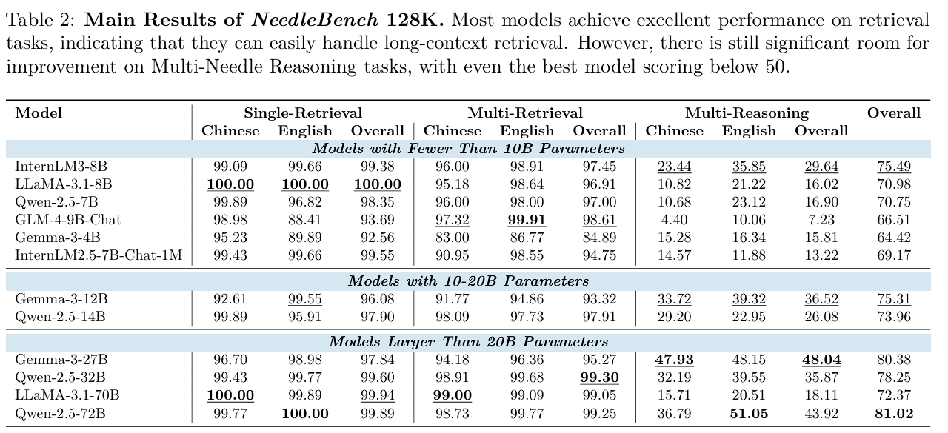
Information-Sparse Tasks: Results
Overall Results:
Evaluation of mainstream open source LLMs at context lengths of 32K and 128K
As in RULER, modern LLMs achieve almost perfect scores in S-RT and M-RT tasks.
Significant dip in performance once reasoning becomes involved

Slide 31
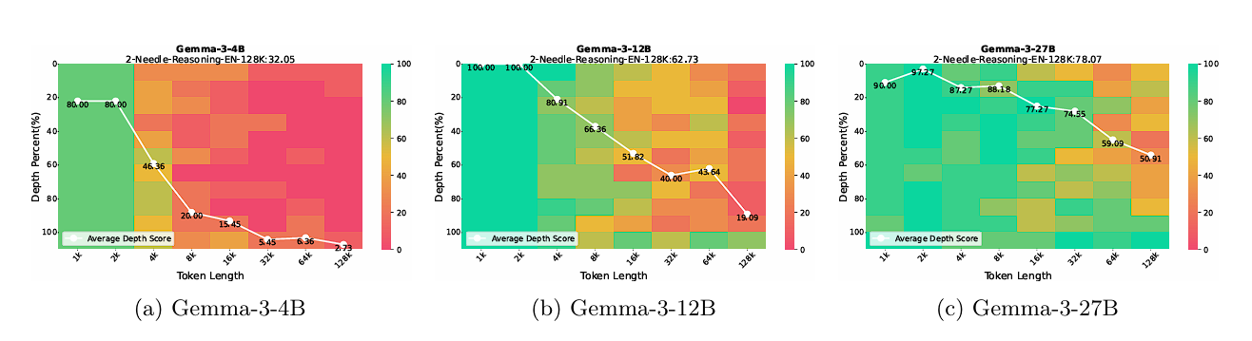
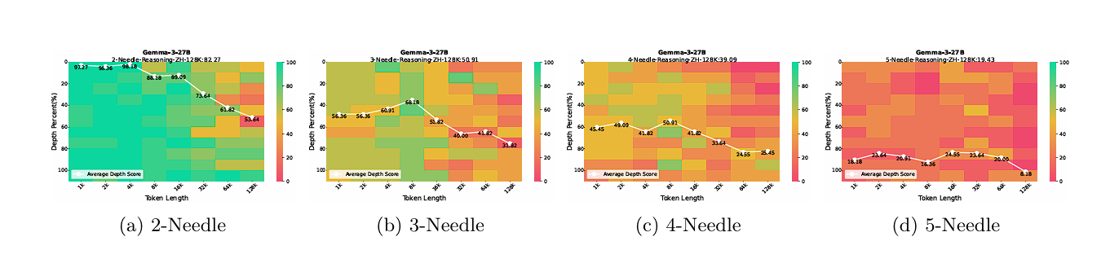
Performance – Generation and Needle Count

Slide 32
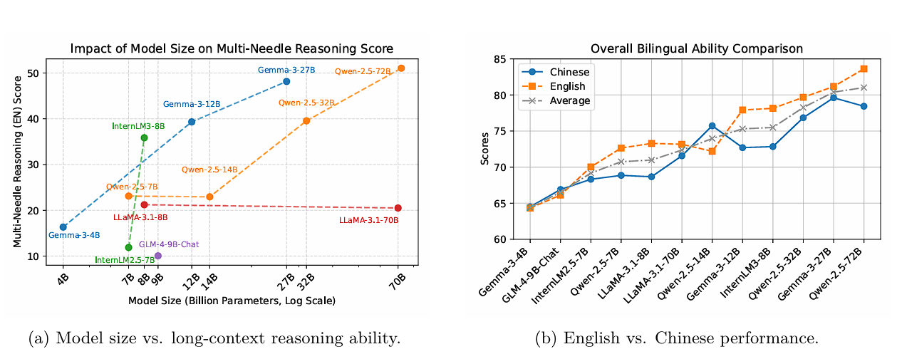
Performance – Model Size and Language

Slide 33
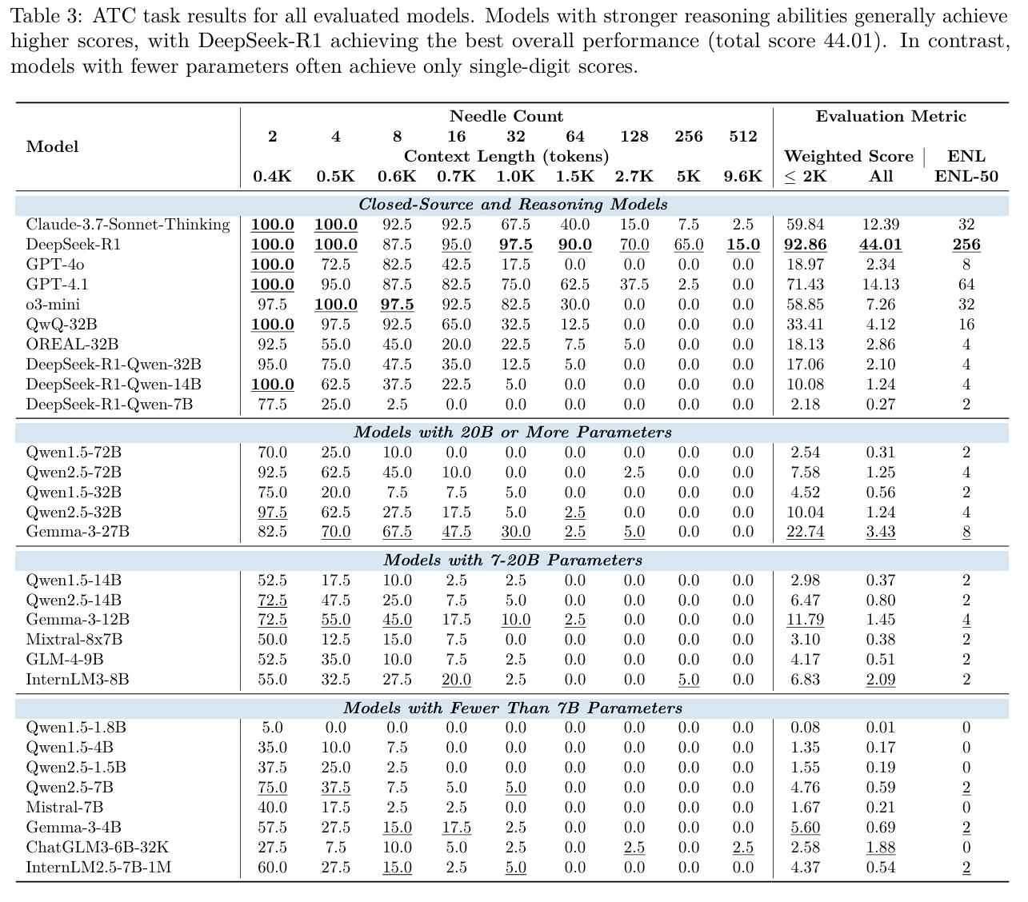
Information-Dense Tasks: Results
Overall Results:
Performance decrease with increased task complexity (needle count)
Increased model size seems to have a positive impact on performance
Model architecture seems to play a significant role – Gemma series performs well across all model sizes

Slide 34
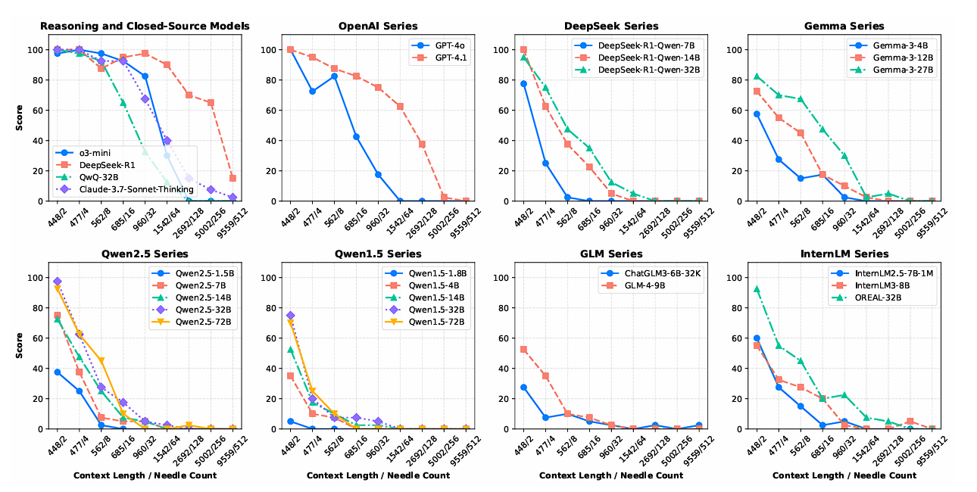
Results - Breakdown

Slide 35
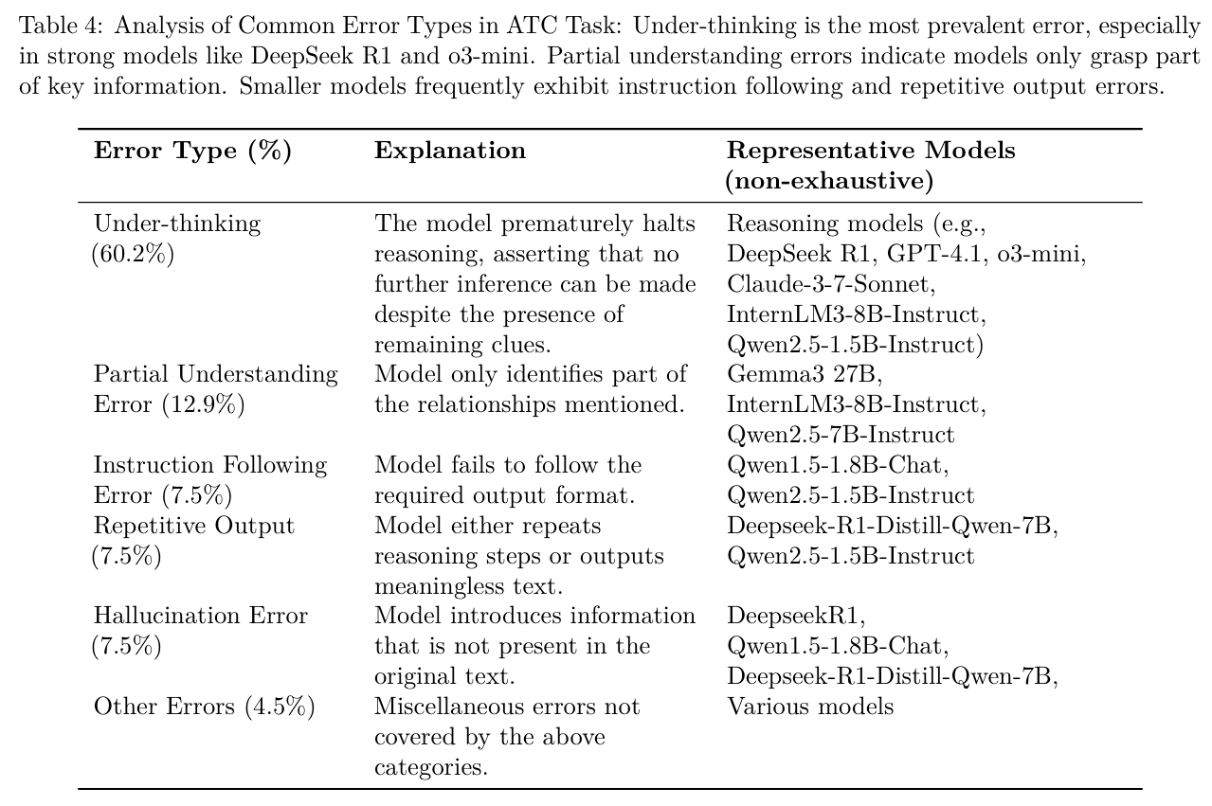
Results – Reasoning Errors

Slide 36
NeedleBench Summary
Findings:
Framework for NIHA testing focused on reasoning ability.
Highlights weakpoints in information-dense, multi-step retrieval and reasoning across extended texts.
Premature conclusion as major weakness of current models.
Limitations:
Tests are still synthetic and may not mirror real world applications.
Heavy focus on Ancestral Trace Challenge

